Slide 1

Notes:
Introduction: Welcome everyone. Today, we are taking a deep dive into "The Four Pillars of Real-World Investing," drawing directly from the insights and empirical philosophy of Dr. William Bernstein—a practicing neurologist turned investment advisor and author of seminal texts like The Four Pillars of Investing and The Intelligent Asset Allocator.
Context: In today's market climate, retail and institutional investors alike are constantly bombarded with noise, technological hype, short-term economic forecasts, and dynamic wall-street products.
Core Thesis: The central message of this masterclass is simple yet profound: Real-world investing is not about solving complex partial differential equations or outsmarting the market on short-term trades. It rests on three critical foundations:
Market Reality: Recognizing valuation extremes and market history without falling for dangerous predictions.
Mechanical Defense: Building anti-fragile, structurally sound income engines (like TIPS ladders) to guarantee your basic financial survival.
Behavioral Discipline: Controlling your own limbic system and evolutionary psychology when panic inevitably hits.
Key Takeaway: As Dr. Bernstein frequently reminds us: The primary goal of investing is not to maximize upside return, but to structurally and behaviorally eliminate catastrophic downside risk.

Slide 2
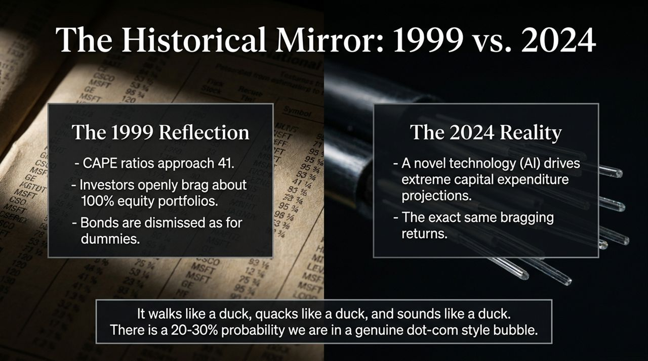
Notes:
Overview: Slide 2 sets the stage by placing our current market environment in historical context, comparing the dot-com era of 1999 with the market climate driven by AI technology today.
The 1999 Reflection:
During the late 1990s, the Shiller CAPE (Cyclically Adjusted Price-to-Earnings) ratio reached unprecedented heights around 41.
Investor sentiment was wildly euphoric. People openly bragged about holding 100% equity portfolios and dismissed fixed-income assets, claiming "bonds are for dummies".
The Present Reality:
Today, we see a striking structural parallel: enthusiasm surrounding a novel technology—Artificial Intelligence—is driving extreme projections for future capital expenditure and productivity growth.
We hear the exact same cultural echo: retail investors bragging about pure stock portfolios and completely discarding defensive fixed income.
Dr. Bernstein’s Assessment:
When an asset market walks like a duck, quacks like a duck, and sounds like a duck, you must treat it with appropriate caution.
Dr. Bernstein notes there is a real 20% to 30% probability that we are currently inside a genuine dot-com style bubble.
Actionable Insight: However, this does not mean you should panic-sell your equities tomorrow. History shows that market timing based on CAPE ratios can leave you stranded on the sidelines for decades (as would have happened if you exited stocks based on valuations in 1990). Instead, it means recognizing market exuberance and ensuring your portfolio is defensively built to survive a major draw-down.

Slide 3
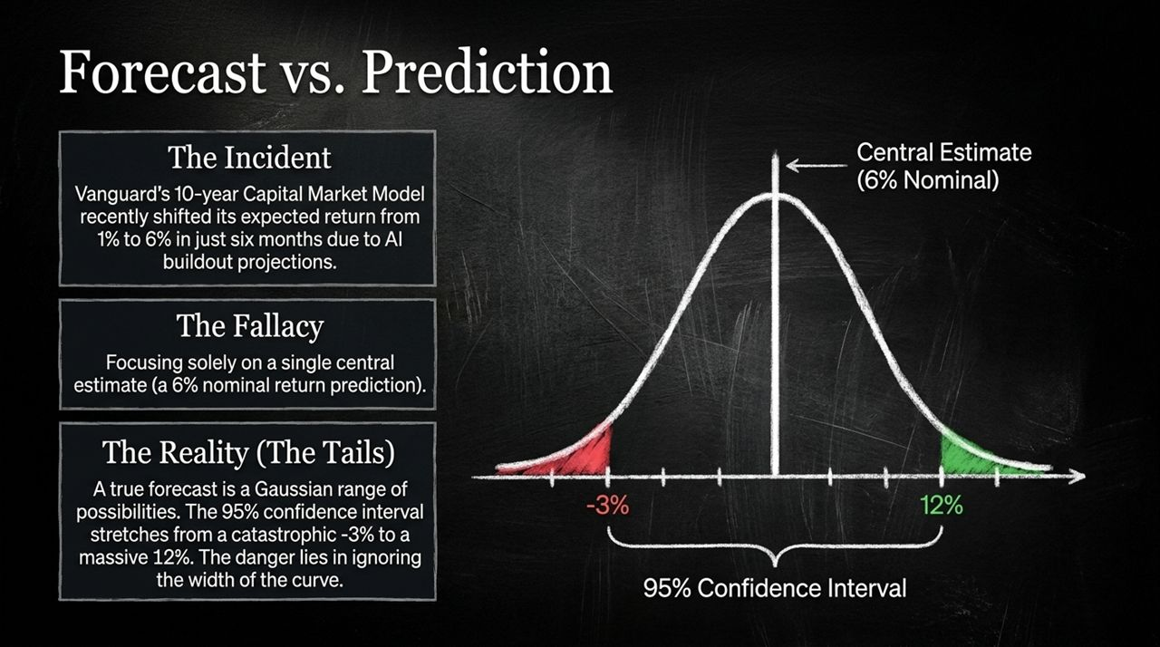
Notes:
Overview: On Slide 3, we address one of the most critical conceptual errors made in modern finance: confusing a prediction with a forecast.
The Incident (Vanguard’s Model):
Take Vanguard’s 10-year Capital Market Model (VCMM). Within a span of roughly six months, their projected 10-year annualized market return shifted dramatically from 1% to 6%, driven largely by revised capital buildout expectations around AI.
When prominent institutions make such rapid multi-percentage-point adjustments based on technological enthusiasm, investors must pause and evaluate what those numbers actually mean.
The Fallacy of Point Predictions:
Most market participants fixate on a single point estimate—a "prediction" that the market will return 6% nominal.
In reality, no model can pinpoint exact long-term point returns. Treating a central estimate as a certainty leads to dangerous overconfidence.
The Gaussian Reality (Tail Risks):
A true financial forecast is a full Gaussian probability distribution range.
While the central estimate may sit at 6% nominal, the 95% confidence interval stretches from a severe -3% annualized return on the left tail to an optimistic +12% return on the right tail.
Key Takeaway: Real investment risk is defined by the width of that curve. Your financial plan cannot rely solely on the central 6% estimate; it must be resilient enough to survive the -3% left-tail outcome over a 10-year horizon.

Slide 4
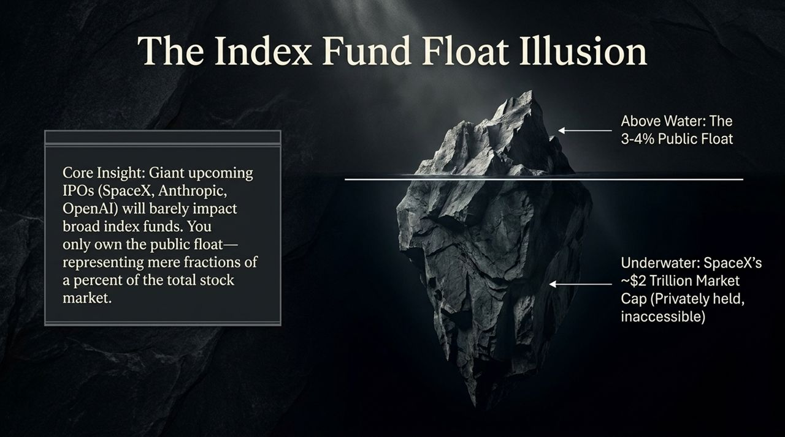
Notes:
Overview: Slide 4 dismantles a widespread myth regarding upcoming mega-tech IPOs (like SpaceX, Anthropic, or OpenAI) and their immediate impact on broad market index funds.
The Concern:
Investors often look at massive private valuations—such as SpaceX estimated at $1.5 to $2 trillion—and worry that when these giants go public, they will suddenly overwhelm broad index funds (like S&P 500 or Total Stock Market indexes) or introduce concentrated risk.
The Core Mechanism — Public Float vs. Total Market Cap:
In broad index funds, you do not own the company's entire market cap; you only own its public float—the portion of shares actively traded on public exchanges.
For instance, even with a multi-trillion-dollar company like SpaceX, if only 3% to 4% of its shares are publicly issued, that public float represents a fraction of a percent (e.g., around 0.1%) of the total S&P 500 index weight.
Underwater Reality:
The massive bulk of private tech valuations remains held underwater by private insiders, venture capital, and institutional founders—completely isolated from public index fund holders.
Key Takeaway: Index fund investors do not need to fear private mega-cap IPO additions. The mechanical structure of market-cap float weighting automatically prevents a newly listed entity from distorting your index portfolio balance.

Slide 5

Notes:
Overview: Slide 5 transitions from market mechanics into neuropsychology, examining why human biology is fundamentally wired to make terrible financial decisions.
The Evolutionary Biological Wiring:
Our brains evolved over hundreds of thousands of years on the plains of the Serengeti in East Africa.
Survival depended on immediate, involuntary fight-or-flight reactions. When peripheral vision detected yellow and black stripes in the brush or the sound of a hiss, the limbic system instantly triggered an adrenaline spike.
The Modern Biological Misfire:
In modern financial markets, we experience a 20% portfolio drop or sudden market volatility with that exact same biological, visceral panic.
Our limbic system reacts to a falling stock chart as if it were a physical predator in the room, driving an overwhelming impulse to sell everything and flee to safety.
The Core Problem:
Short-term market drops are not physical threats. Reacting to short-term volatility with split-second biological panic forces investors to buy high during periods of euphoria and sell low during crashes.
Key Takeaway: To succeed in investing, you must recognize that your immediate emotional instincts are evolutionary misfires. Real long-term financial success requires mastering your limbic system through rigid, automated behavioral protocols.

Slide 6
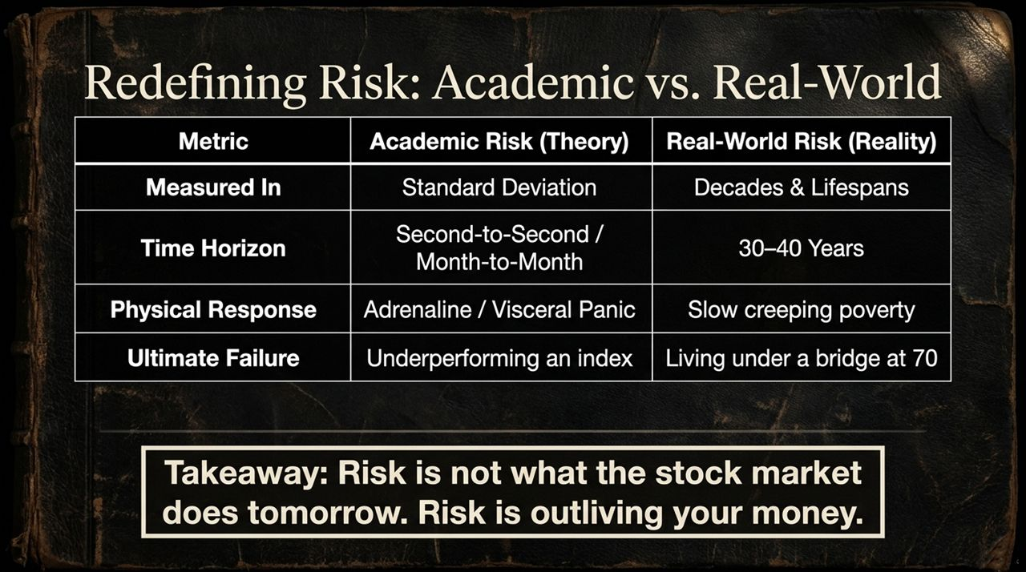
Notes:
Overview: Slide 6 contrasts the theoretical definition of risk taught in finance literature with the actual, lived reality of risk for individual human beings.
Academic Risk (Theory):
Academia measures risk using Standard Deviation and volatility.
Its time horizon is second-to-second, month-to-month, or year-to-year price movement.
In academia, "failure" is defined as underperforming a benchmark or suffering short-term tracking error.
Real-World Risk (Reality):
In the real world, volatility is not risk. Real-world risk is measured across decades and entire lifespans (30 to 40 years).
The physical response to academic risk is short-term adrenaline and panic. The real-world consequence of bad risk management is slow, creeping poverty in old age.
Ultimate failure in real-world investing is not failing to beat the S&P 500 by 50 basis points; ultimate failure is living under a bridge at age 70 because you ran out of money.
The Two Paths to Disaster:
Dr. Bernstein emphasizes that you can wind up "under a bridge" in two opposite ways:
Investing too aggressively right before retirement, suffering a severe market drop, and exhausting your principal.
Investing too conservatively in T-bills your entire life out of fear, letting inflation quietly erode your purchasing power.
Key Takeaway: Risk is not what the market does tomorrow. Risk is outliving your money.

Slide 7
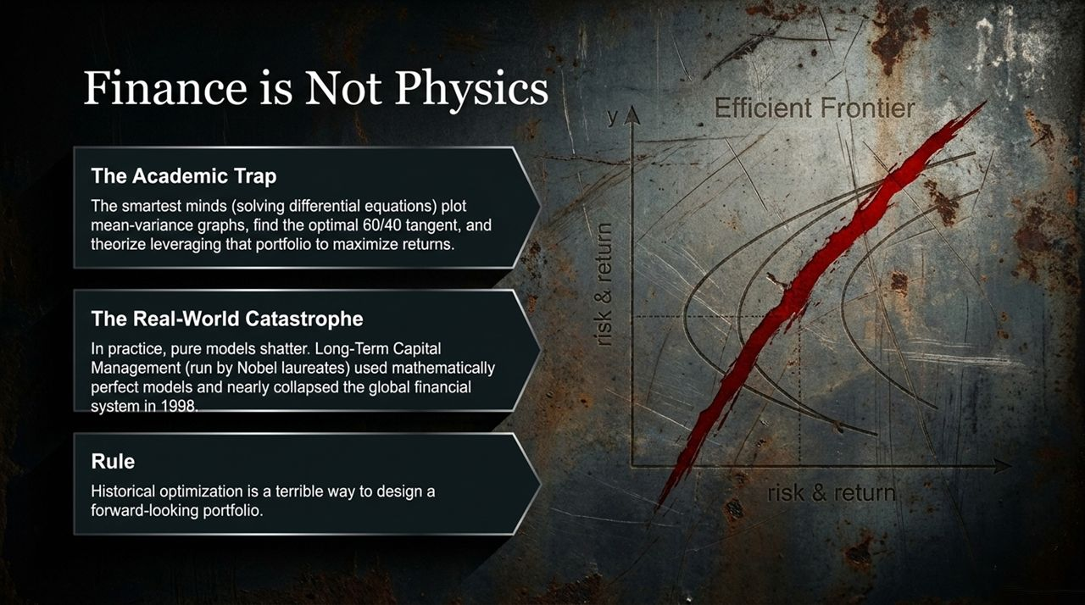
Notes:
Overview: Slide 7 warns against the "Academic Trap"—the danger of over-relying on elegant mathematical models in an domain governed by human behavior.
The Academic Trap:
In financial academia, highly intelligent quantitative minds plot mean-variance graphs, optimize expected returns, locate the "tangent point" on the efficient frontier (often a 60/40 mix), and theorize leveraging that portfolio to maximize returns.
They treat market dynamics like physics equations—assuming stable statistical distributions and rational actors.
The Real-World Catastrophe:
Finance is not physics; market participants are driven by psychology, fear, and liquidity crunches.
A prime historical lesson is Long-Term Capital Management (LTCM) in 1998. Run by Nobel laureates and mathematical geniuses, LTCM created mathematically optimal models. Yet when real-world market correlations broke down during the Russian debt default, their extreme leverage nearly collapsed the entire global financial system.
The Rule:
Historical optimization is a terrible way to design a forward-looking portfolio.
Optimizing a portfolio based on past data tells you what would have worked in the last cycle, but rarely what will survive the next unpredictable shock.

Slide 8

Notes:
Overview: Slide 8 introduces one of Dr. Bernstein’s most famous principles: "If you've won the game, stop playing".
Reframing the Objective:
Investing is not a video game where the person with the highest balance wins. The goal of investing is to secure your real-world living standards for the rest of your life.
The Defeasement Formula:
To operationalize this, you calculate your annual Residual Spending Need:
Suppose your base living expenses in retirement are $70,000/year.
You expect $30,000/year from Social Security (or guaranteed pension).
Your residual gap is $40,000/year.
To defease (guarantee) 25 years of essential spending:
$$\$40,000×25 \text{years}=\$1,000,000 \text{Target}$$
Core Insight:
Once you have accumulated the $1,000,000 required to fund your basic residual needs, take that money off the table and lock it into mechanically risk-free, inflation-protected assets.
Do not keep taking equity risk with money required for basic food and shelter just to see your wealth number grow higher. Secure your base, and only play for upside with true surplus capital.

Slide 9

Notes:
Overview: Slide 9 details the primary mechanical tool recommended for defeasing retirement expenses: individual Treasury Inflation-Protected Securities (TIPS) ladders.
What is a TIPS Ladder?
A TIPS ladder involves purchasing individual TIPS bonds on the secondary market structured so that one bond matures in each consecutive year of your retirement (e.g., 2027, 2028, 2029...).
As each rung matures, it delivers guaranteed cash flow adjusted directly for CPI inflation to cover your baseline rent, utilities, and groceries.
Understanding Secondary Market Pricing & The Inflation Factor:
Buying individual bonds on the secondary market can confuse investors because two mechanisms work in opposite directions:
Market Discount: Due to rate hikes in recent years, a bond might quote at a discount (e.g., 90 cents on the dollar).
Inflation Index Ratio: If a 30-year bond was issued 15 years ago, its principal has accumulated 15 years of inflation adjustments (e.g., an inflation multiplier of 1.6).
The Net Price: A $1,000 face value bond selling at 90 cents might actually cost you ~$1,440 ($1,000 × 0.90 × 1.6). Investors must account for the inflation index ratio when purchasing.
The Structural Gap:
Note that the U.S. Treasury currently has a gap in TIPS issuances maturing in years 37 to 39. Those missing rungs must be covered using short-term cash/T-bills or cash buffers.
Practical Execution:
A helpful resource for modeling individual bond structures is tipsladder.com. Dr. Bernstein advises investors intimidated by secondary bond markets to simply buy a single $1,000 TIPS bond in an IRA to see how the mechanics settle.

Slide 10
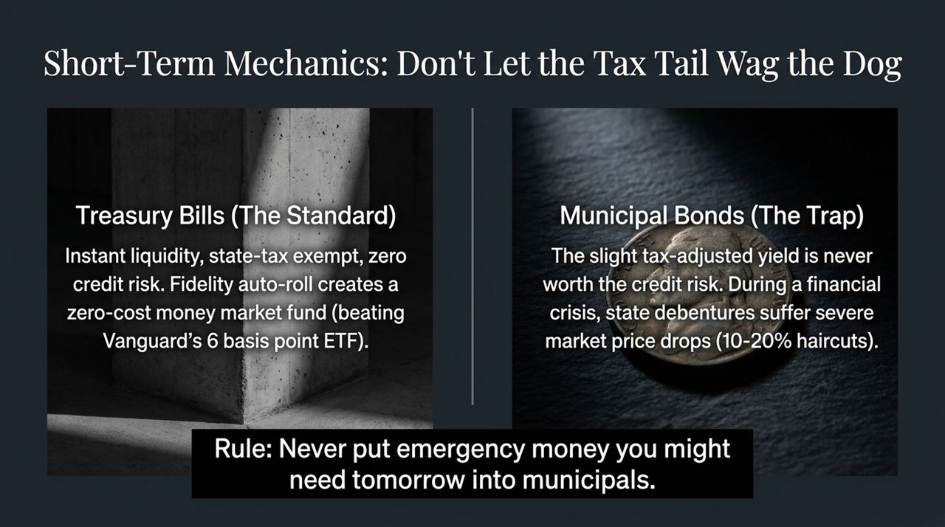
Notes:
Overview: Slide 10 focuses on short-term liquidity management and warns against taking hidden risks in pursuit of minor tax savings.
Treasury Bills (The Gold Standard for Emergency Cash):
For short-term cash reserves and 6-to-12-month emergency funds, T-Bills are unmatched. They provide instant liquidity, carry zero credit risk, and are state-tax exempt.
Brokerage Execution: Brokerages like Fidelity offer an "Auto-Roll" feature for 1-, 3-, or 6-month T-Bills. This creates a zero-expense-ratio money market alternative, avoiding the 6-basis-point fees charged by short-term Treasury ETFs.
Municipal Bonds (The Municipal Trap):
High earners often flock to California or New York municipal bond funds to avoid state and federal income tax.
The Hidden Danger: In pursuit of a slight tax-adjusted yield gain, investors take on underlying credit and market liquidity risk. During major financial crises (like 2008), municipal bond prices can fall dramatically, forcing 10% to 20% haircuts if sold in a panic.
The Golden Rule:
Never put money you might need tomorrow into municipal bonds. Keep emergency reserves strictly in risk-free U.S. Treasury Bills.

Slide 11
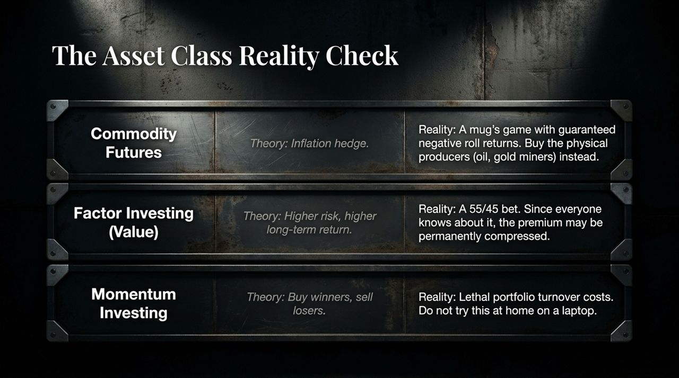
Notes:
Overview: Slide 11 conducts a pragmatic "reality check" on popular niche strategies: Commodity Futures, Factor/Value Investing, and Momentum Investing.
1. Commodity Futures:
Theory: Acts as an inflation hedge.
Reality: A mug's game. Buying futures contracts exposes you to a negative "roll return" when rolling maturing contracts in contango markets. Futures funds historically lose around 5% per year relative to spot prices. If you want commodity exposure, buy the physical producers (e.g., oil companies, gold/base metal miners) rather than futures contracts.
2. Factor Investing (Small/Value):
Theory: Value and small-cap stocks carry higher risk and offer higher long-term expected returns.
Reality: A "55/45 bet". Because factor premiums are widely known and heavily traded, the value premium has experienced long periods of underperformance over the last 15 years. It requires extreme patience and a strong stomach to stick with factor tilting when it underperforms broad market indexes.
3. Momentum Investing:
Theory: Buy recent winners, sell recent losers.
Reality: High portfolio turnover generates heavy drag, implementation costs, and tax inefficiencies. Do not try this at home on a laptop.

Slide 12

Notes:
Overview: Slide 12 addresses structural shifts in Social Security and why younger generations (Millennials and Gen Z) must build independent financial defense plans.
The Boomer Reality:
Baby Boomers benefited from a uniquely favorable economic tailwind: starting careers when asset valuations were historically low and enjoying uninhibited fee structures and un-depleted entitlement benefits.
The Millennial/Gen Z Future:
Millennials sit on the cusp of significant fiscal adjustments. While Social Security will not disappear entirely, high-earning professionals (such as physicians, engineers, and executives) must prepare for aggressive means-testing.
Income Replacement Realities:
Low-income workers receive nearly a 90% salary replacement rate from Social Security. High earners currently receive around 15% to 20%.
In the future, high earners may see their baseline Social Security replacement rates compressed to 10–15%.
Key Takeaway: High earners cannot rely on state safety nets to preserve their lifestyle. You must build your own mechanical TIPS defeasement ladder and personal capital reserves to guarantee retirement independence.

Slide 13
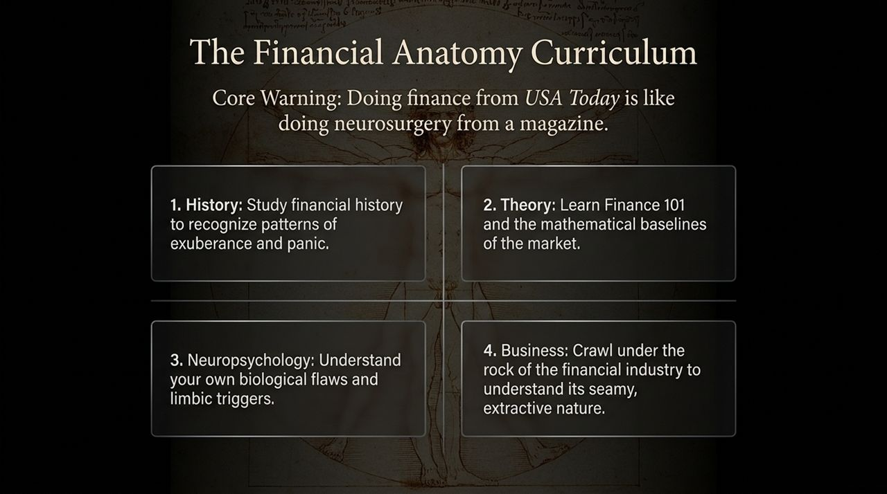
Notes:
Overview: Slide 13 presents Dr. Bernstein's core warning on financial education and outlines the 4-part curriculum required to become a competent investor.
The Core Warning:
"Doing finance from USA Today or Money Magazine is like doing neurosurgery from a pop magazine."
You would never treat a medical patient without studying peer-reviewed science, yet people routinely risk their entire life savings based on media headlines and casual blog posts.
The 4 Essential Pillars of Financial Education:
Financial History: Study historical bubbles, panics, and manias (from the South Sea Bubble to 1999 and 2008) so you recognize market exuberance and panic when it happens.
Finance Theory: Master Finance 101—understand discounted cash flow models, bond duration, real yields, and asset allocation baselines.
Neuropsychology: Study behavioral finance. Understand your limbic triggers, loss aversion, and evolutionary biases so you don't sell during market crashes.
The Financial Industry (Business): Crawl under the rock of the financial industry to understand its extractive nature. Recognize how high fees, complex products, and sales incentives are designed to transfer wealth from your pocket to Wall Street.

Slide 14

Notes:
Overview: Slide 14 brings our journey back to the single most decisive factor in investor success: personal temperament and behavioral discipline.
The Limits of Intelligence:
Academic models fail when market conditions shift, historical bubbles repeat, and mechanical rules fall apart if you lack the emotional fortitude to execute them.
Buffett’s Rule:
As Warren Buffett famously noted: "Finance isn't a game where the person with an IQ of 160 beats the person with an IQ of 130."
The Real Benchmark:
The ultimate winner in real-world investing is simply the individual with the discipline to stay the course.
Success is measured entirely by your ability to suppress your limbic system during moments of severe market panic.
It is easy to commit to a 60/40 rebalancing plan on a spreadsheet; it is extraordinarily difficult to execute when your portfolio is down 35% and financial news channels are predicting global collapse. Your emotional control under stress determines your ultimate financial survival.

Slide 15

Notes:
Overview: Slide 15 synthesizes the core mandate of real-world investing into a single guiding principle.
The Common Misconception:
Most investors approach the market asking: "How can I maximize my upside return?" They chase high-flying tech sectors, dynamic factor timing, and aggressive predictions.
The Real-World Mandate:
The goal of real-world investing is not maximizing upside.
The goal is structurally, mechanically, and behaviorally eliminating catastrophic downside risk.
Summary of Defense:
Structurally: Avoid extreme leverage and speculative bubbles.
Mechanically: Build a TIPS ladder to defease essential living expenses once you have 'won the game'.
Behaviorally: Maintain strict emotional control, ignore short-term volatility, and respect the width of historical uncertainty.

Slide 16
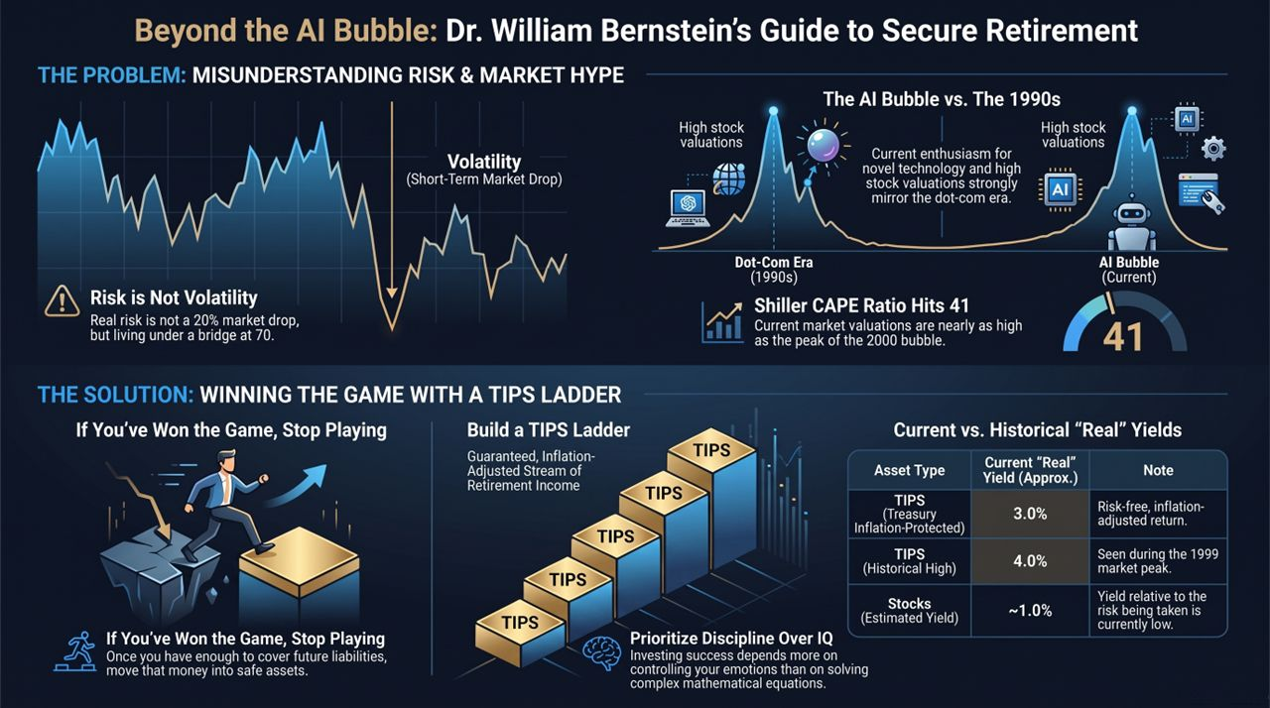
Notes:
Overview: Slide 16 serves as a visual executive summary, wrapping up the presentation’s main pillars for quick review.
1. Identifying the Problem (Market Hype & Risk):
High valuations driven by novel AI excitement strongly resemble the 1990s dot-com era. Shiller CAPE ratios near 41 warn us that future equity returns relative to risk-free assets may be compressed.
Remember that true risk is not short-term market drops (volatility), but permanent capital loss leading to poverty in retirement.
2. Executing the Solution (Winning the Game):
Stop Playing: Once you have accumulated enough capital to cover core retirement liabilities, lock in those expenses.
Build a TIPS Ladder: Leverage real yields (~3%) to create a inflation-adjusted, risk-free stream of income for essential spending.
Prioritize Discipline: Recognize that emotional regulation and adherence to basic financial principles will always outperform high IQ and complex financial engineering.
Closing Statement: Thank you all for your time. Focus on building an anti-fragile portfolio, master your behavioral responses, and protect your baseline for life.
I’ve Seen This Market Before — William Bernstein
https://www.youtube.com/watch?v=Eu_NV9nR1uY

